Slide 1
Learned Cardinality Estimation: A Design Space Exploration and A Comparative Evaluation
Ji Sun, Jintao Zhang(co-first author), Zhaoyan Sun, Guoliang Li*, Nan Tang
Department of Computer Science, Tsinghua University
http://dbgroup.cs.tsinghua.edu.cn/
Reporter: Jintao Zhang
Learned Cardinality Estimation: A Design Space Exploration and A Comparative Evaluation
Notes:
大家下午好，今天我为大家分享关于查询和查询计划表示的相关研究工作；并在最后提出自己的思考

Slide 2
Outline
Introduction
Cardinality Estimation
Motivation
Design Space
SOTA learned Cardinality Methods
Unified workflows
Dimensions of comparison and Metrics
Experiment
Setting
Results and Analysis
Summary
Reporter: Jintao Zhang
Learned Cardinality Estimation: A Design Space Exploration and A Comparative Evaluation

Slide 3
Cardinality Estimation
Problem Formulation:
Cardinality: The result size of a query.
Input: A SQL Query.
Output: An Estimated Cardinality.
Data table
or
SQL with true cardinality
，132
SQL query
Model
estimated
cardinality
130
Cardinality Estimation Example
Reporter: Jintao Zhang
Learned Cardinality Estimation: A Design Space Exploration and A Comparative Evaluation

Slide 4
Traditional Cardinality Estimation
Sampling
Core idea: Estimating selectivity of target query by sampling.
Limitation: Inference is slow and inaccurate when the amount of data is large.
Histogram
Core idea: Store the value distribution of each attribute, and calculate the selectivity according to the independence assumption.
Limitation: Strong independence assumption makes it inaccurate when the data distribution is complex.
Reporter: Jintao Zhang
Learned Cardinality Estimation: A Design Space Exploration and A Comparative Evaluation

Slide 5
Learned Cardinality Estimation
Motivation
Due to the attribute value independence assumption as well as the assumption of uniform distribution, traditional cardinality estimation methods tend to fail when the data distribution is complex.
Optimization Goal
Accuracy, Inference Latency, Training Latency
Categories
Supervised Query Methods
Supervised Data Methods
Unsupervised Data Methods
Reporter: Jintao Zhang
Learned Cardinality Estimation: A Design Space Exploration and A Comparative Evaluation

Slide 6
Supervised Query Methods for Cardinality Estimation
Problem Definition
A regression problem: learn the mapping function between query and its actual cardinality.
Supervised Model Training
Online Cardinality Estimation
Queries
Well-Trained
Query Model
Query
Model
Cardinalities
Queries
Cardinalities
Optimizer
Reporter: Jintao Zhang
Learned Cardinality Estimation: A Design Space Exploration and A Comparative Evaluation

Slide 7
Supervised Data Methods for Cardinality Estimation
Problem Definition
A density estimation problem: learn a joint data distribution of each data point. (except for the pre-training summarization model)
Supervised Model Training
Cardinality Estimation
Data
Sampler
Data
Model
Well-Trained
Data Model
Queries
Cardinalities
(Queries with true cardinalities)
Dataset
Optimizer
Reporter: Jintao Zhang
Learned Cardinality Estimation: A Design Space Exploration and A Comparative Evaluation

Slide 8
Unsupervised Data Methods for Cardinality Estimation
Problem Definition
A regression problem: learn a probability function for each data point.
Unsupervised Model Training
Cardinality Estimation
Queries
Data
Sampler
Data
Model
Well-Trained
Data Model
Cardinalities
Dataset
Optimizer
Reporter: Jintao Zhang
Learned Cardinality Estimation: A Design Space Exploration and A Comparative Evaluation

Slide 9
Motivation
Learned methods have shown superior performance than non-learned methods for cardinality estimation.
Under different data characteristics, different learned methods perform very differently.
There is no detailed comparison experiments conducted to verify the performance of each method under different data characteristics.
Goals：
A design space exploration
A comparative evaluation
A cardinality-estimation testbed
https://github.com/jt-zhang/CardinalityEstimationTestbed
Reporter: Jintao Zhang
Learned Cardinality Estimation: A Design Space Exploration and A Comparative Evaluation

Slide 10
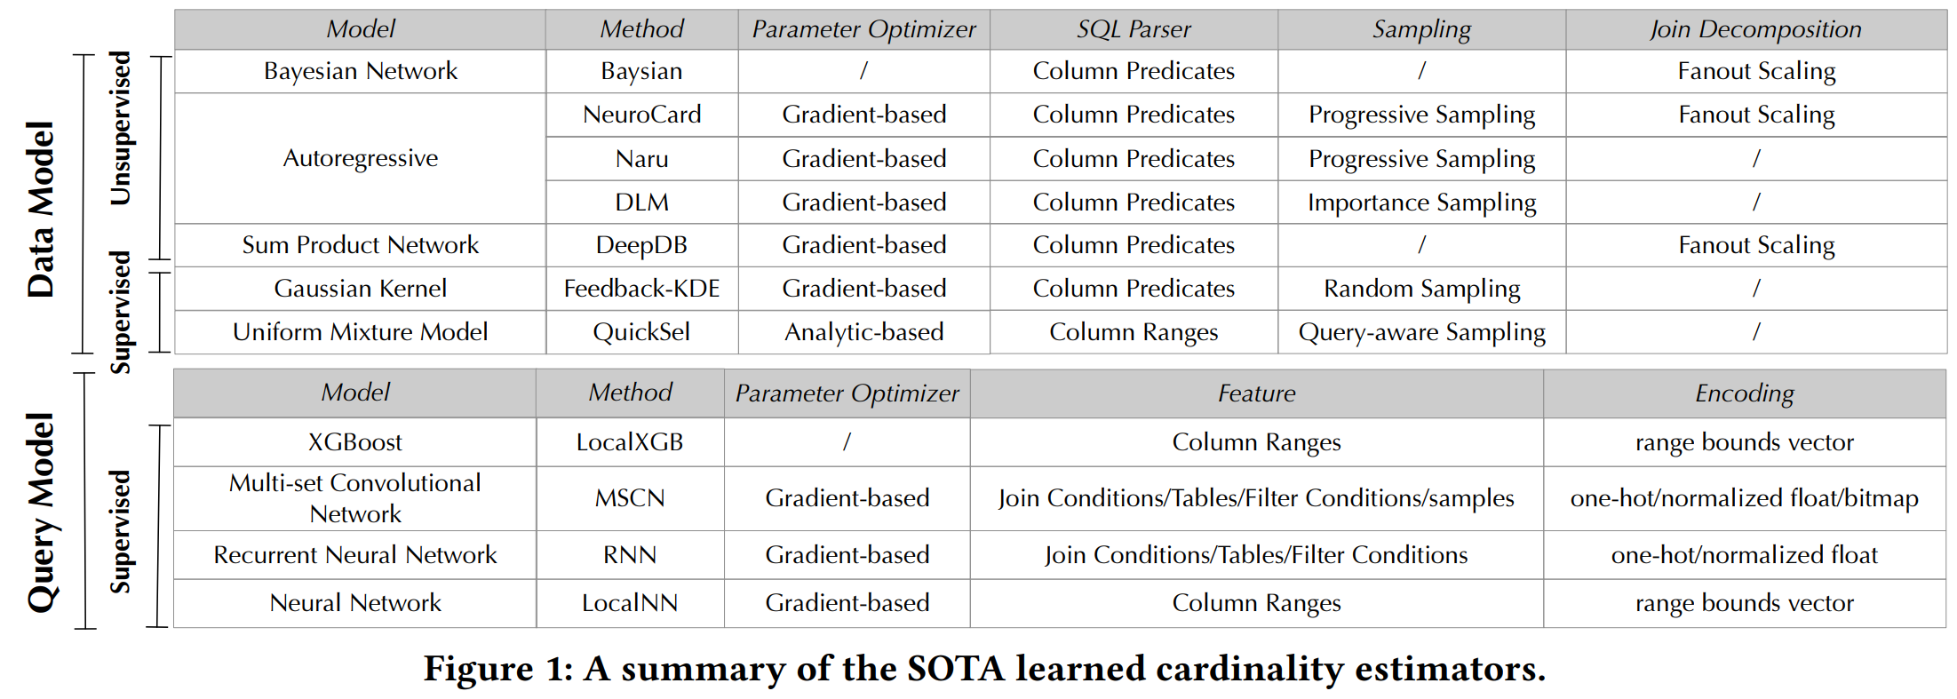
SOTA learned Cardinality Methods
Reporter: Jintao Zhang
Learned Cardinality Estimation: A Design Space Exploration and A Comparative Evaluation

Slide 11
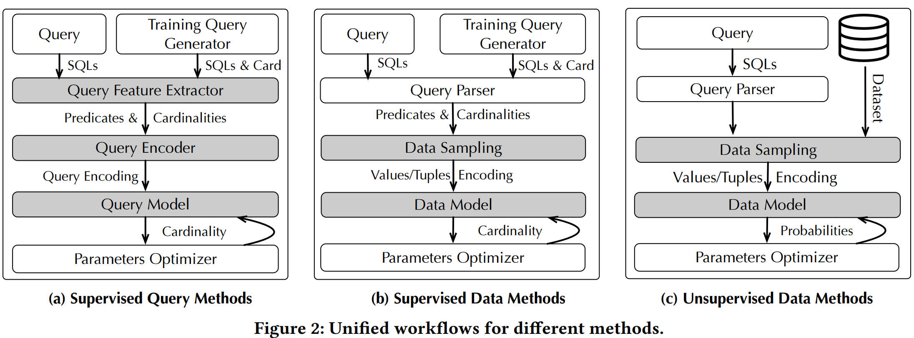
Unified workflows
Reporter: Jintao Zhang
Learned Cardinality Estimation: A Design Space Exploration and A Comparative Evaluation

Slide 12
Dimensions of Comparison and Metrics
Dimensions
Overall Comparison
Varying the #Columns
Varying the #Distinct values
Varying Correlation among columns
Varying Skewness of column
Varying the #Training queries
Varying the #Join sample
Metrics
Accuracy
Inference Latency
Training Latency
Update Latency
Reporter: Jintao Zhang
Learned Cardinality Estimation: A Design Space Exploration and A Comparative Evaluation

Slide 13
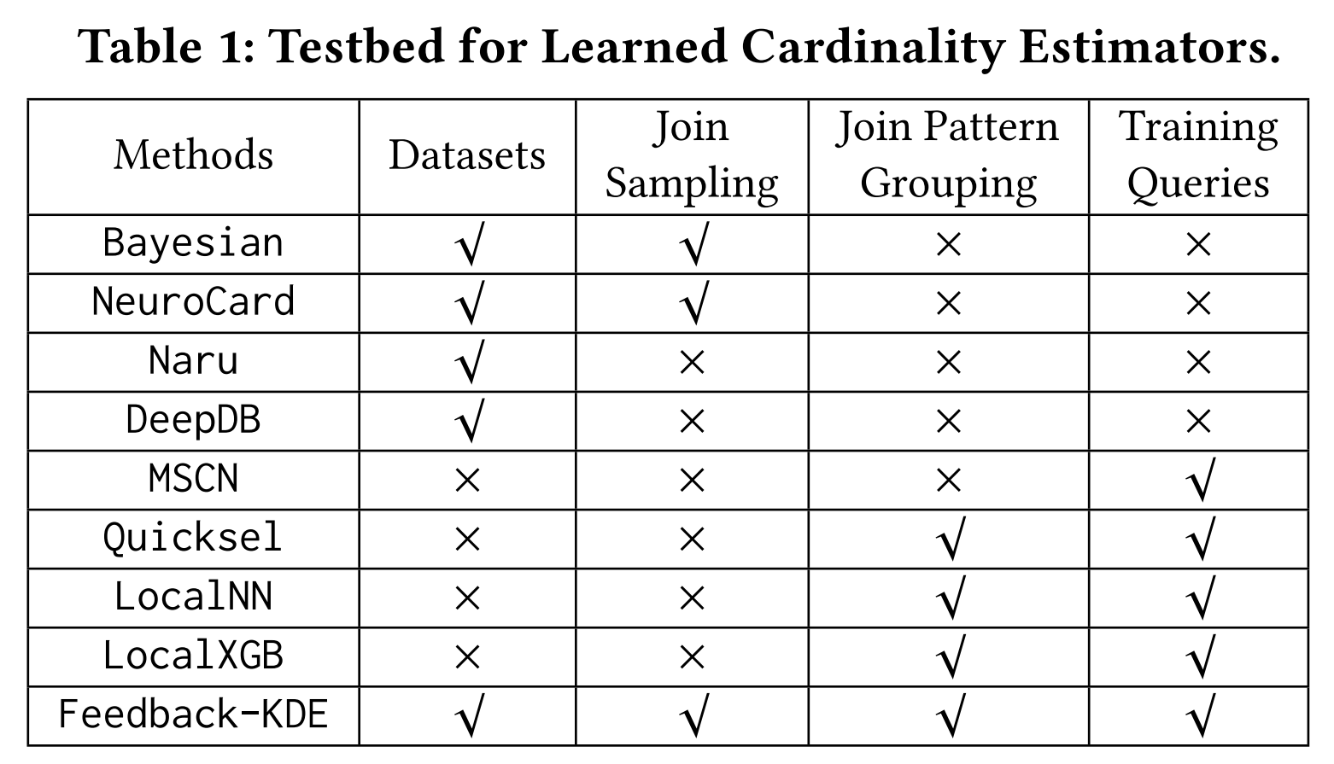
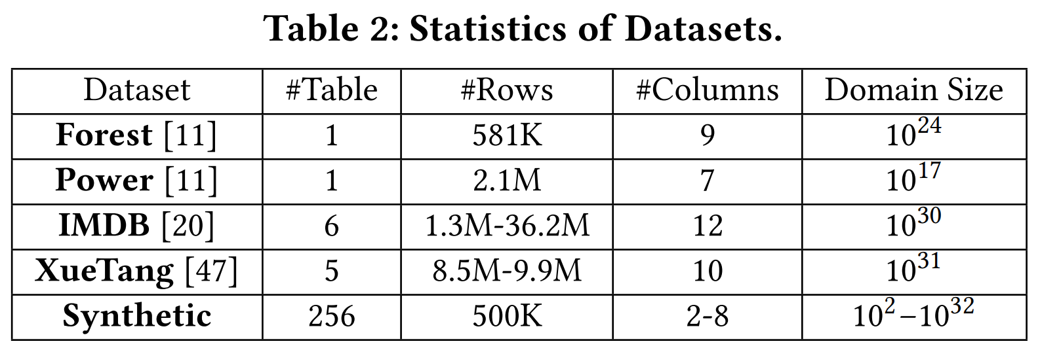
Experiment Setting
Cardinality Estimators
Datasets
Parameters of Synthetic datasets
Reporter: Jintao Zhang
Learned Cardinality Estimation: A Design Space Exploration and A Comparative Evaluation

Slide 14
Results on Real-world dataset
Unsupervised estimators, Naru and DeepDB, outperform other methods on single real tables Forest and Power.
MSCN outperforms other data model based methods on IMDB that requires to join several tables.
Reporter: Jintao Zhang
Learned Cardinality Estimation: A Design Space Exploration and A Comparative Evaluation

Slide 15
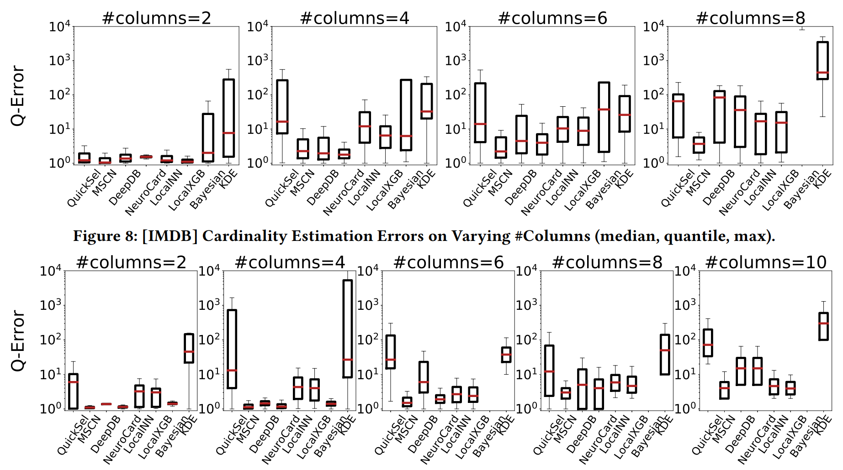
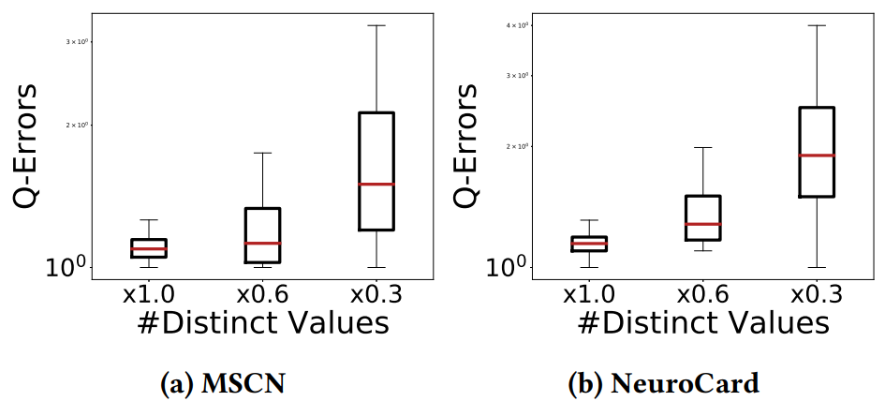
Accuracy on Real-world dataset
Different #columns
Different #distinct values
Reporter: Jintao Zhang
Learned Cardinality Estimation: A Design Space Exploration and A Comparative Evaluation

Slide 16
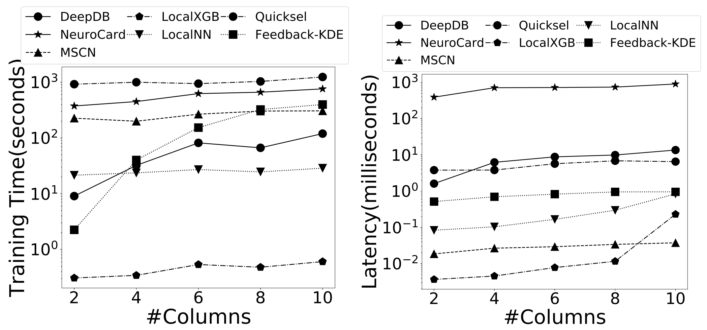
Latency on Real-world dataset
Training Latency on IMDB
Inference Latency on IMDB
Training Latency on XUETANG
Inference Latency on XUETANG
Reporter: Jintao Zhang
Learned Cardinality Estimation: A Design Space Exploration and A Comparative Evaluation

Slide 17
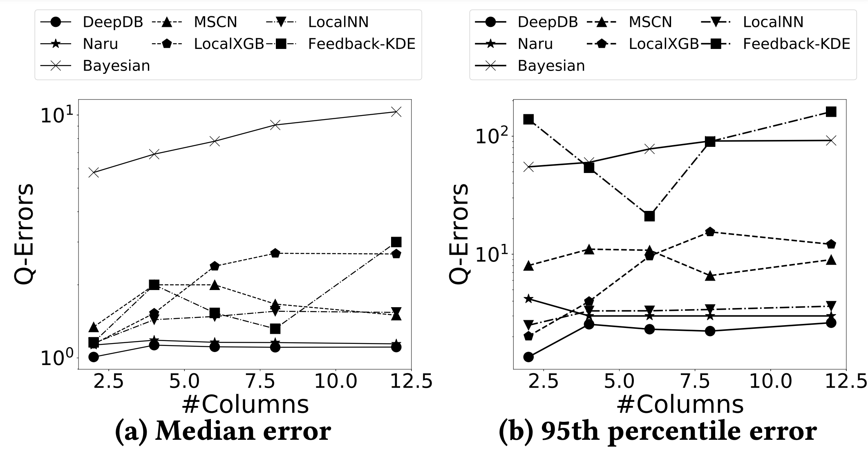
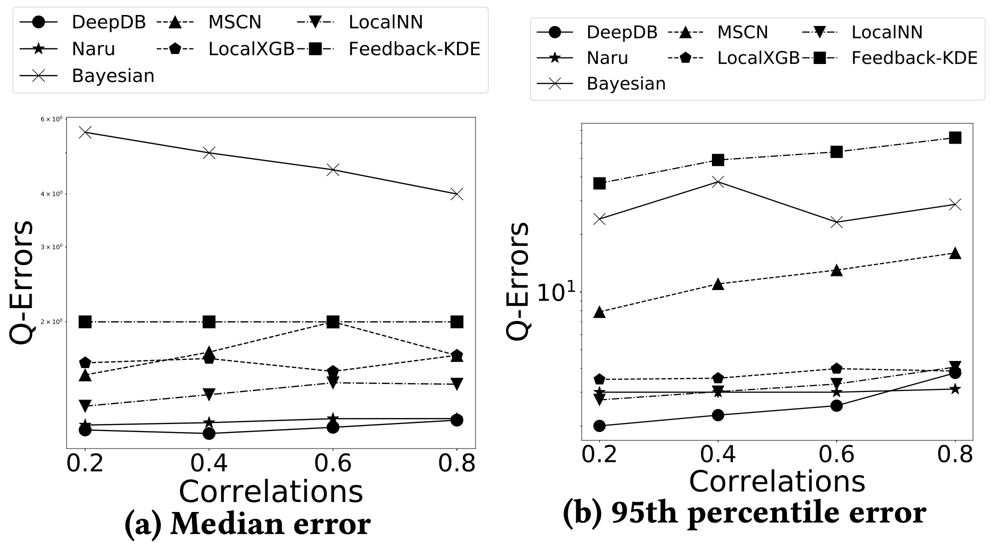
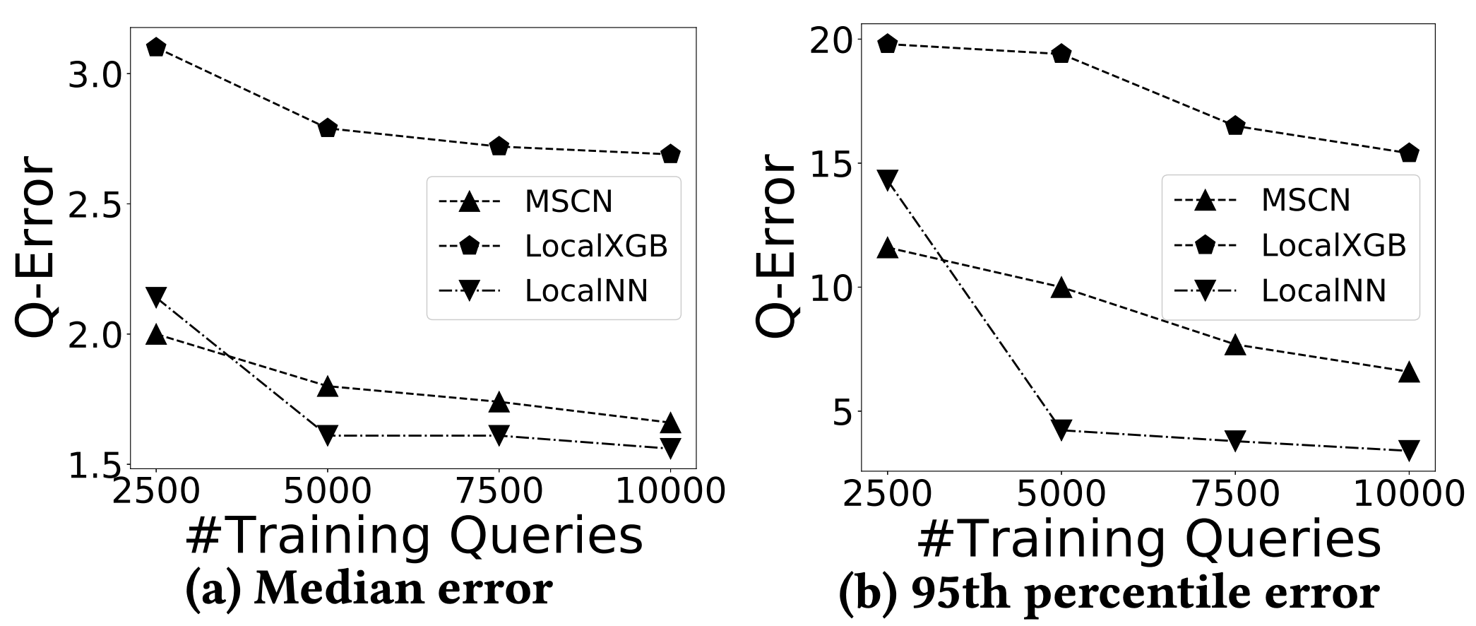
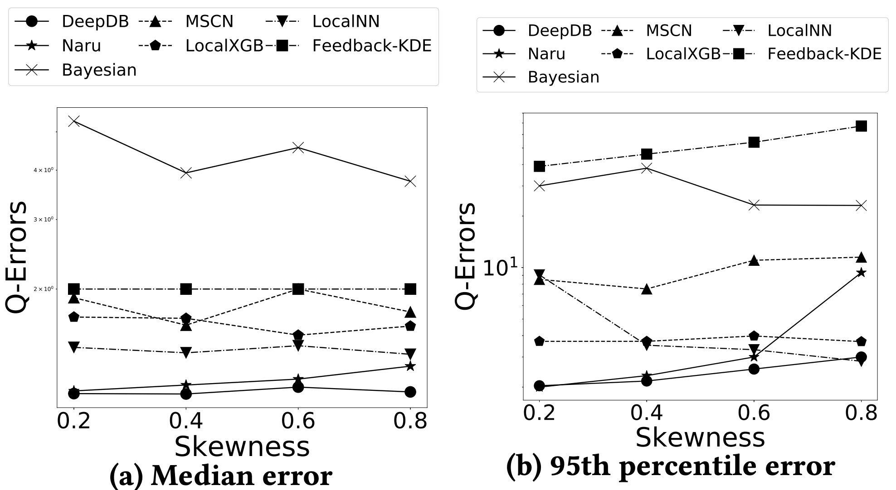
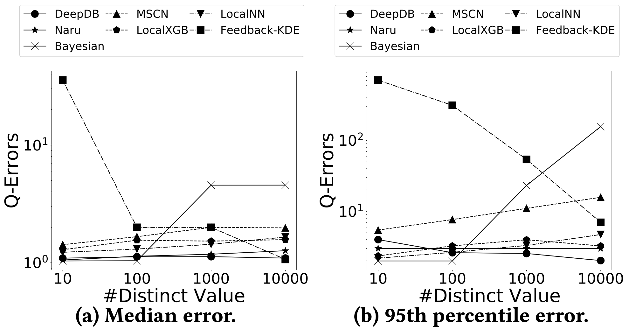
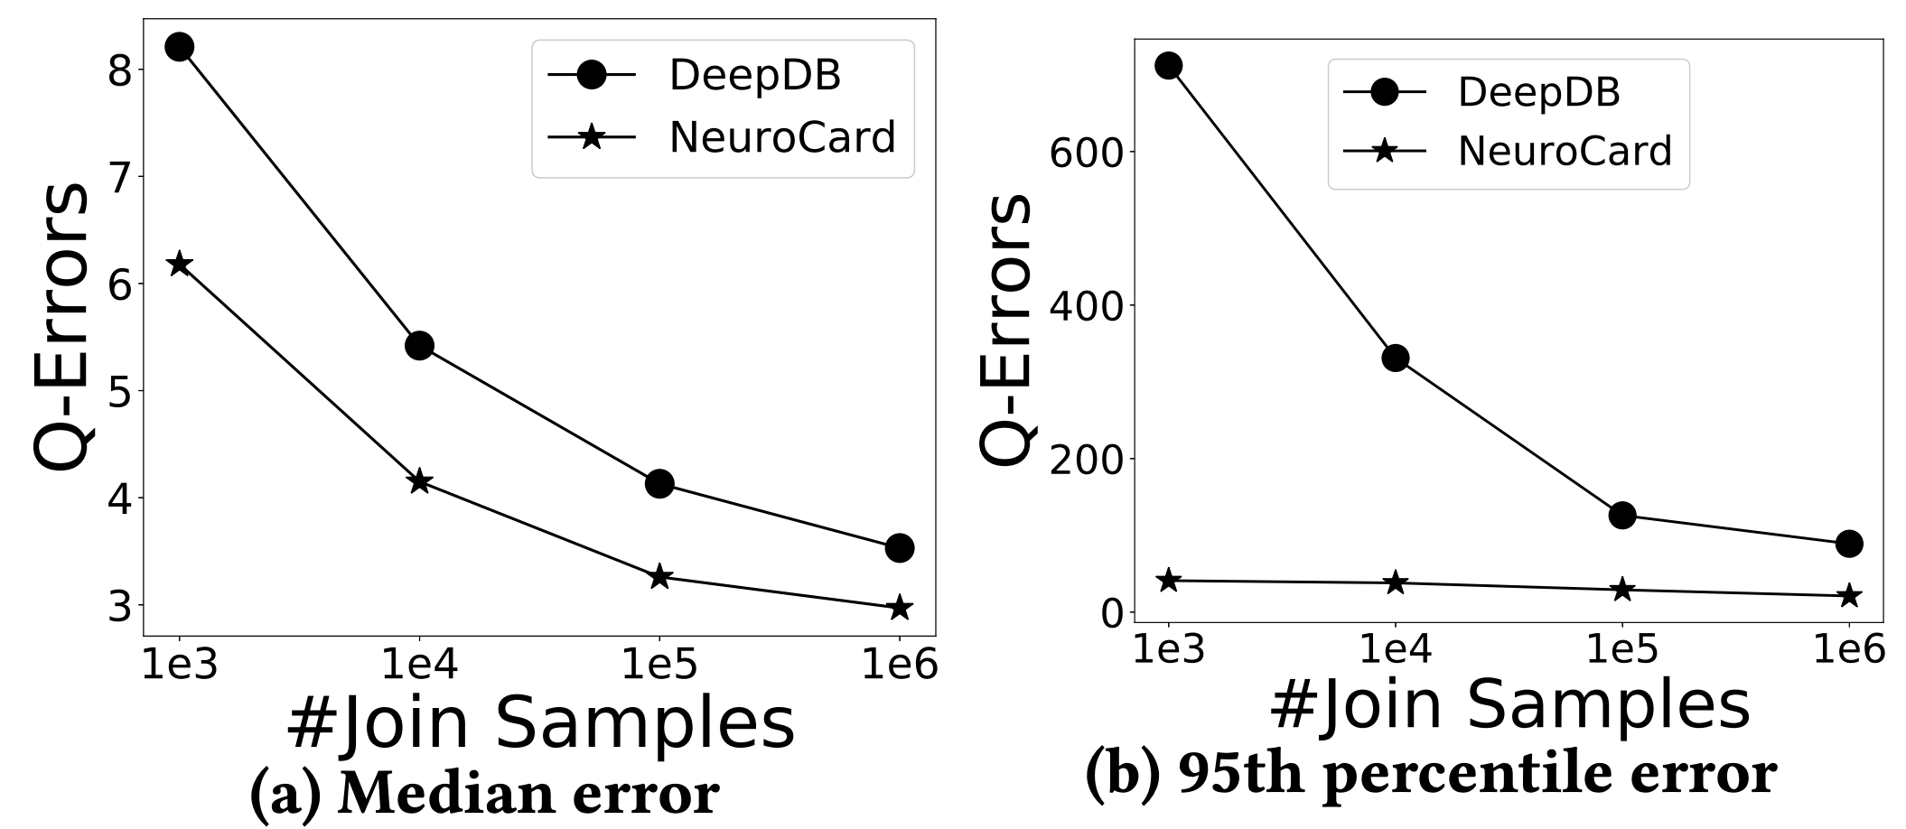
Accuracy on synthetic datasets
Different #columns
Different correlation
Different #training queries
Different skewness
Different #distinct values
Different #join sample
Reporter: Jintao Zhang
Learned Cardinality Estimation: A Design Space Exploration and A Comparative Evaluation

Slide 18
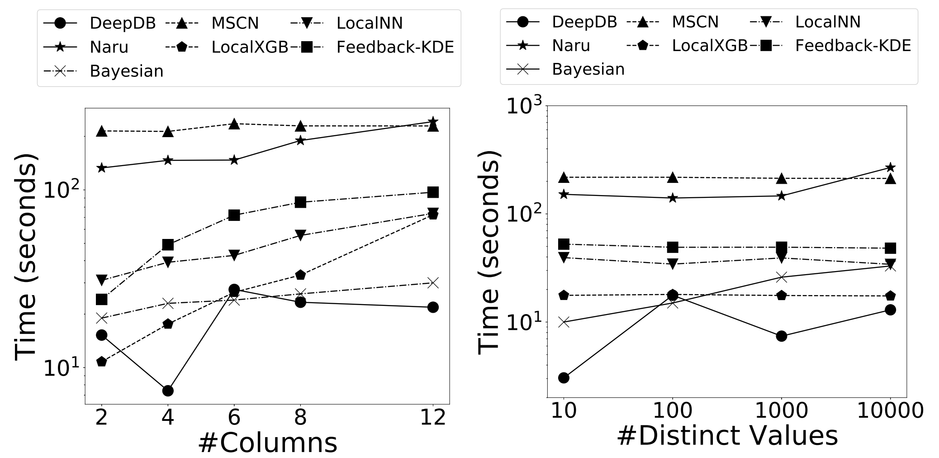
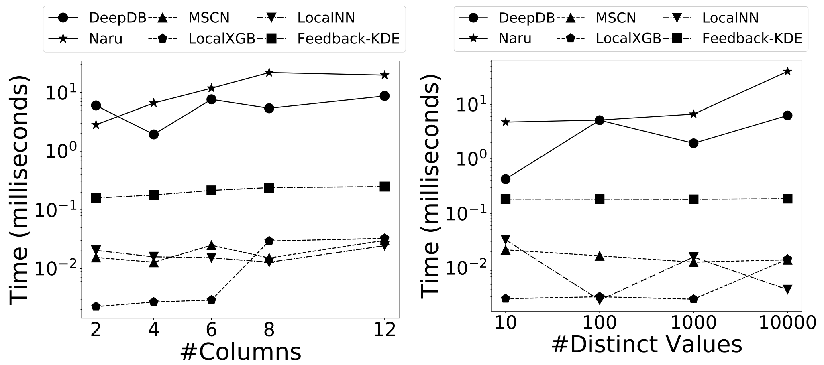
Latency on synthetic datasets
Training Latency on Synthetic dataset
Training Latency on Synthetic dataset
Reporter: Jintao Zhang
Learned Cardinality Estimation: A Design Space Exploration and A Comparative Evaluation

Slide 19
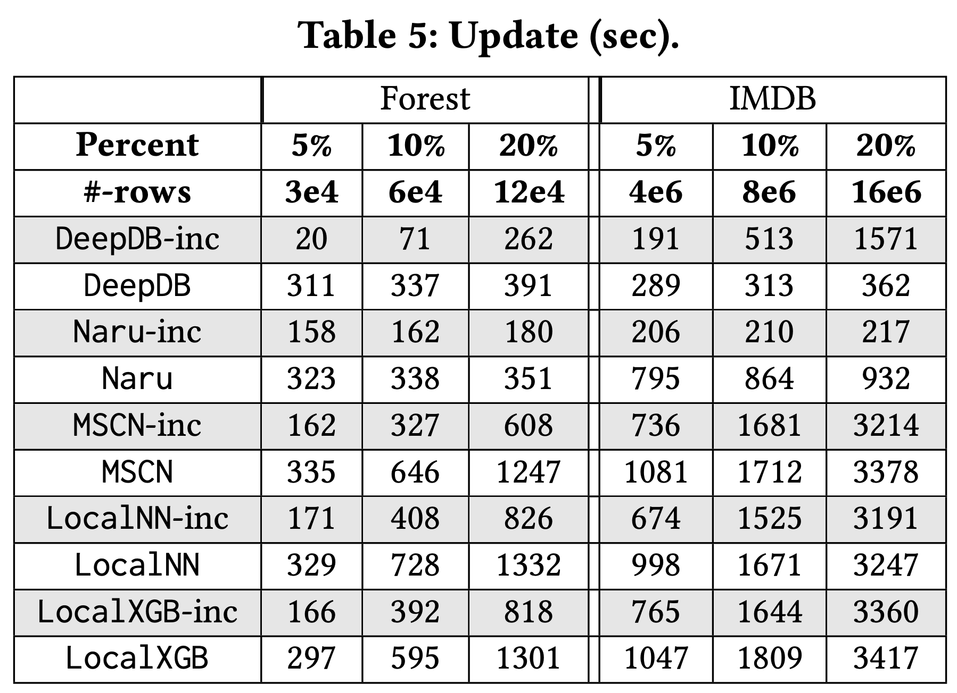
Update Latency
Update Latency on Real-world datasets
Reporter: Jintao Zhang
Learned Cardinality Estimation: A Design Space Exploration and A Comparative Evaluation

Slide 20
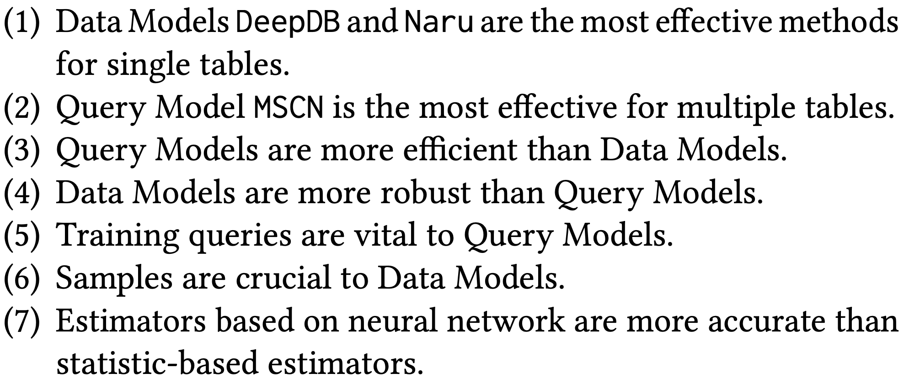
Summary
Reporter: Jintao Zhang
Learned Cardinality Estimation: A Design Space Exploration and A Comparative Evaluation

Slide 21
Thanks
http://dbgroup.cs.tsinghua.edu.cn/
Reporter: Jintao Zhang
Learned Cardinality Estimation: A Design Space Exploration and A Comparative Evaluation

